Slide 1

Log File Management
Log File System Organization
(V1.0 Final – Nov-2016)

Slide 2
Target of Task
Today‘s Target
Define a log file organization!
(file system related)

Slide 3
Recap: Project Outline
Phase 1
Define a core log file management system comprising core format and core file organization ^{*)}
Setup a log file management key group
Align core definitions with key group
First alpha test
Phase 2
Define log file format specifics with key group
Each new logging has to be implemented according to core format and format specifics
Phase 3
Define file organization with key group
Implement log file management dialogs in machine SW (library)
Each new logging has integrated log file dialogs
Phase 4
Case-by-case backward integration of log file management
Case-by-case implementation of data base functionality
*) already done (HUPR, FLSP, EMSO)

Slide 4
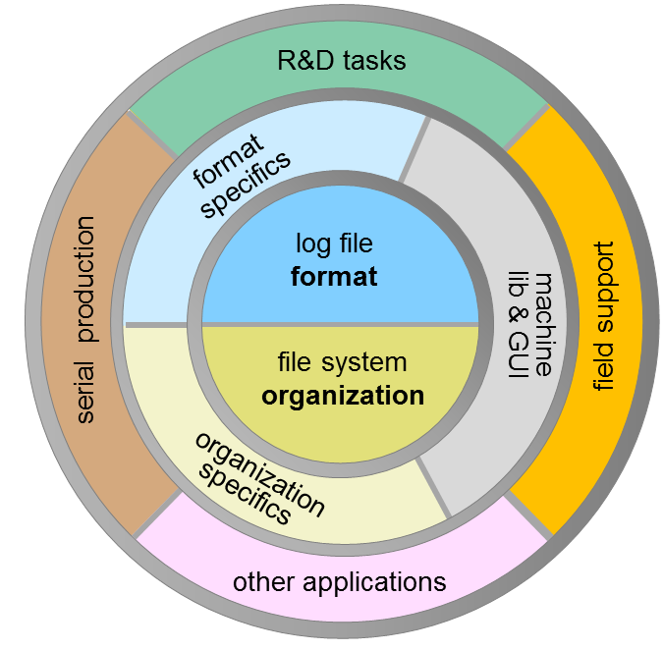
Definition & Implementation in Layers
Log File Management Structure
Core Layer
log file format
file system organization
2) Specifics Layer
format specifics
organization specifics
3) Application Layer
R&D tasks
field support
serial production
other applications
LFM 1.0 focus

Slide 5
Log File System
Organization

Slide 6
Basic Organization Structure
Log files are always contained in log packages (simply: packages)
Packages are (uniquely) identified by a package ID.
The package ID starts with a ‚@‘ character followed by a max 6 digit number (without leading zeros) characterizing the machine plus a continued number (without leading zeros) separated by a period (e.g. @4567.28 or @2377.2)
A package is represented as a folder with a specific naming syntax that contains one or more log files of equal type, optionally supported with additional files.
The naming syntax of a package name is
The text must comply to allowed file name characters (is in no means allowed to contain non-ASCII characters)
Examples: @4567.28.VIB Vibration tests left&right, @4567.28.MBC
package ID
@
digits
.
integer
.
package name
package ID
.
type
text
_

Slide 7
Miscellaneous
An empty unit is represented as ‘[]‘ in the header line (don‘t use ‘[ ]‘!)
Change of existing log file needs all members of the log file key group to be informed (so they can raise their hands in case of issues)
The machine number representation as part of the package ID consists of max 6 digits (Datacon: since current Datacon numbers are defined by two leading zeros plus 4 least significant digits of the machine number, e.g. 004153 => @4153.xxx)
For the running number part of a package ID no leading zeros are allowed (with the benefit of shorter package IDs)
The type representation in both package name and the type clause inside of a log file comprises a redundandance with potential conflict. In case of a conflict the type clause inside the log file overwrites the type information of the package name. Additionally MATLAB toolboxes might report a consistency mismatch for such mismatches.

Slide 8
Log Root
All log files complying to the LFM 1.0 specifications have to be stored under one unique folder, which is called log root.
Suggested name for the log root is

Slide 9
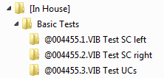

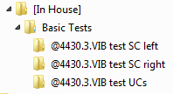


Log File Types
There is a unique (extendable) list of type identifiers
If a log file contains information of multiple log objects, all log objects must be of the same type
A package folder can only contain log files of the same type, which has to match the type information incorporated in the package folder name
Import routines of analysis tools which detect a mismatch between type information of the log file contents and type information incorporated in the package name shall prioritize the type information of the log file contents!
Example
contains
contains
contains

Slide 10
Project Context Transition
initial
context
new project
new project
open project
new package
default
context
open project
project
context
run a test
close project
run a test

Slide 11
Project Context Control
begin test
no
yes
project context
parent folder
for new package folder
is type subfolder
of log root
parent folder
for new package
folder is current
project folder
test type
changed?
create new package
folder in proper
parent folder
perform test and log data
end test

Slide 12
Thank You

